Slide 1

Maximizing Term Deposit Subscription Rates
By: Ashton Dunn

Slide 2

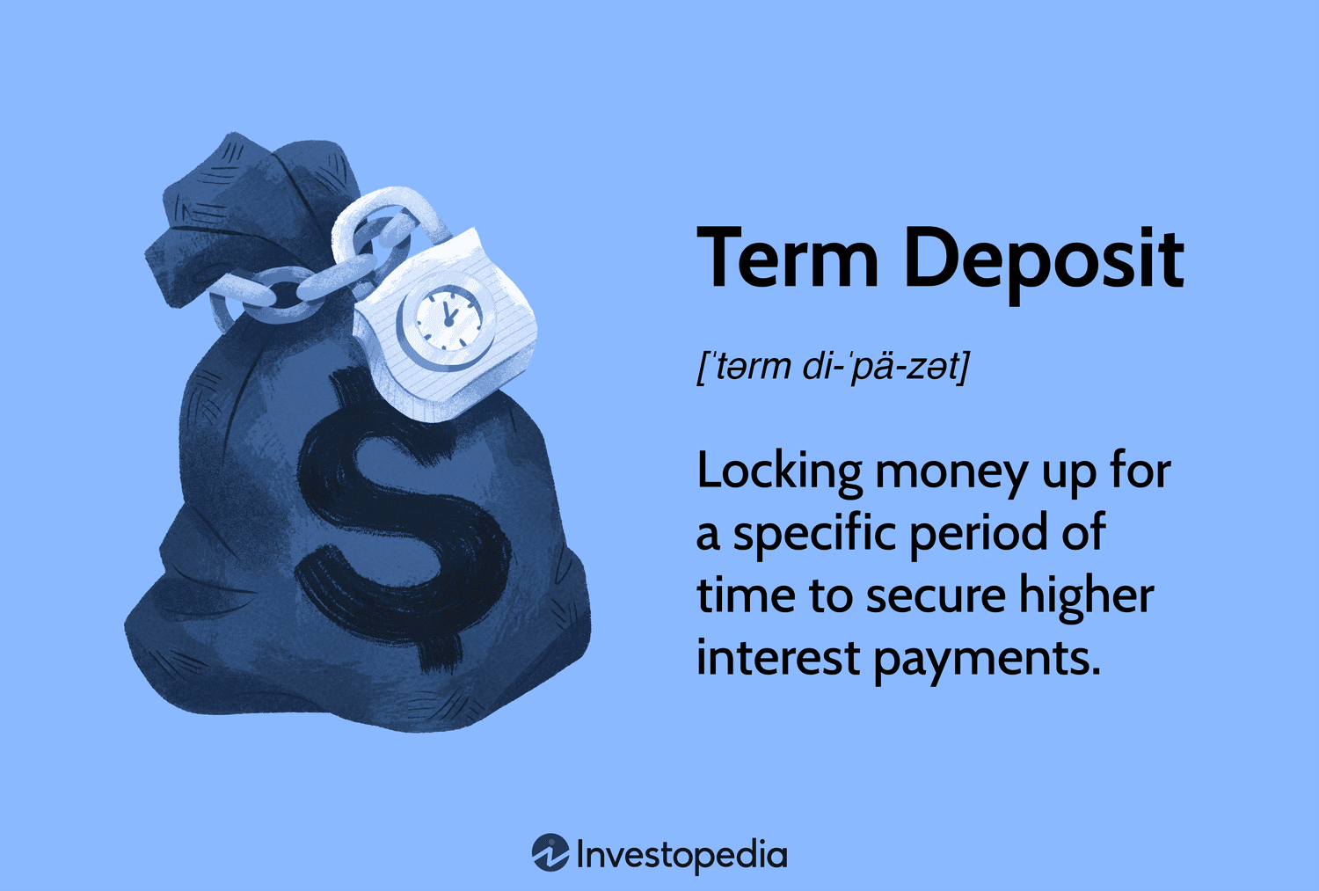

Slide 3
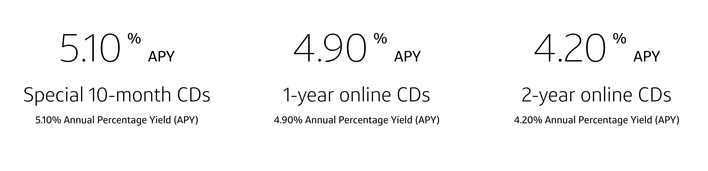
Capital One example

Slide 4

Banks need to make $
Investing
Expecting higher returns
Loaning
Charging higher interest rates

Slide 5
Average Subscription Rate 11.3%

Slide 6



Focusing on…
People previously called 2 or more times
Administrators, Housemaids, Managers, Retirees, Students, Technicians, Unemployed
Basic 4 year education, Professional Course, University Degree
…is 5.3 times more effective.

Slide 7
41,188 instances

Slide 8

The data
Portuguese Banking Institution
Marketing campaign data
Economic Data
Client Data

Slide 9
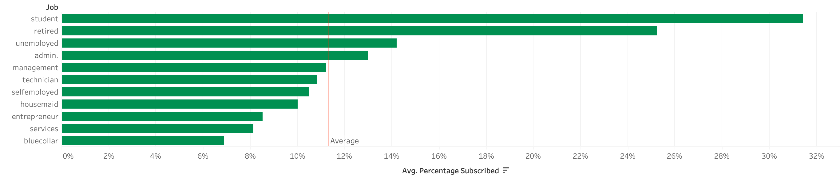


Students and retirees are about 2-3 times more likely to subscribe

Slide 10


Each additional contact doubles the chance of subscription

Slide 11

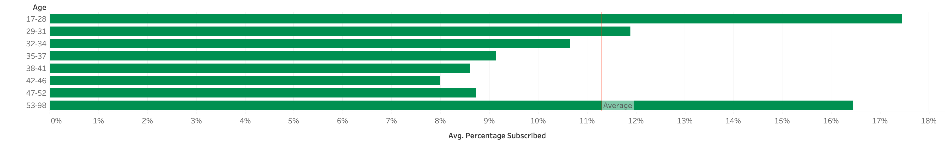
Avoid middle-aged customers

Slide 13





Areas for expansion
Economic conditions
Alternative marketing
Income information
Gender Information
Hometown Information

Slide 14
Sources
Capital One. “Certificates of Deposit (CDs).” Capital One, www.capitalone.com/bank/cds/online-cds/?gclsrc=aw.ds&gclsrc=aw.ds&gclid=CjwKCAjwh4-wBhB3EiwAeJsppPSLV3NR-LuCvfLwmuJM75F7FTqJoiFdCU55bK4lBlDAJ8KNhqsn6xoCs7EQAvD_BwE.
Investopedia. “Term Deposit Definition.” Investopedia, 10 Dec. 2021, www.investopedia.com/terms/t/termdeposit.asp.

